Slide 1
Complex VRP Path Optimization Algorithm
IE 533 UIUC
Robert Enescu, Sachit Vasudeva, Hrithik Rathi

Slide 2
Introduction
VRP involves an optimization problem designing routes for a fleet of vehicles to fulfill the demands of a set of customers
Modern VRP models differ significantly from the original ones from the 1950s and 60s, as they attempt to incorporate real-life complexities such as time-dependent travel times, time windows for pickups and deliveries, and dynamic demand information.
The classical VRP assumes that customer demands are known and fixed, and the goal is to minimize the total distance traveled by vehicles. However, in many real-world cases, customer demands are stochastic and uncertain, which presents a significant challenge for the VRP.
The Stochastic Vehicle Routing Problem with Profit Maximization (VRP-SDPM) involves delivering oil products to customers with uncertain demands
Customers are willing to pay a premium fee, but the supplier cannot guarantee delivery due to capacity constraints and opportunity costs

Slide 3
Objectives
The primary objective of the complex VRP path optimization algorithm is to solve a multi-constrained path optimization problem for a large network that involves stochastic properties.
Identify and cluster common nodes to generate sub networks based on demand for specific product/service.
Sort destination nodes based on greatest profit to prioritize which demands should be served.
Solve VRP for each sorted sub network to optimize the path taken by available vehicles for each type of demand.
Due to the stochastic nature of the data, the algorithm must be designed with flexibility in mind to allow for easy data transfer and import for timely results.
The algorithm must use standardized methods of importing demand destination node data to maximize flexibility and minimize time to generate results in a dynamic environment.

Slide 4
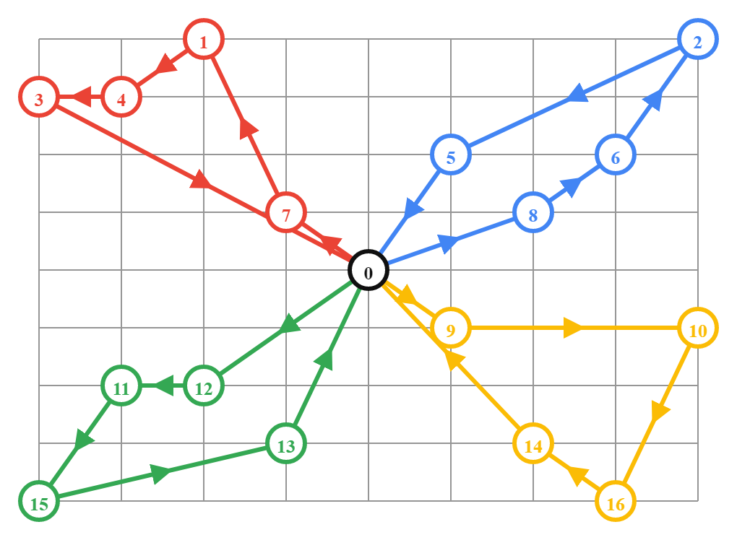
Complex VRP MILP Formulation
Step 1: Stochastic customer orders are released at start of day (location, reward)
Step 2: VRP Algorithm clusters demand nodes of same product type
Step 3: VRP Algorithm sorts nodes based on profitability, selects most profitable & feasible n many nodes for delivery that day
Step 4: VRP Algorithm optimizes the path for each sorted cluster of n many customer nodes
Objective:
“Maximize the profit function P = revenue rewarded at each destination node minus the cost of delivery to those nodes subject to supply capacity, number of vehicles, and individual vehicle supply capacity constraints”

Slide 5
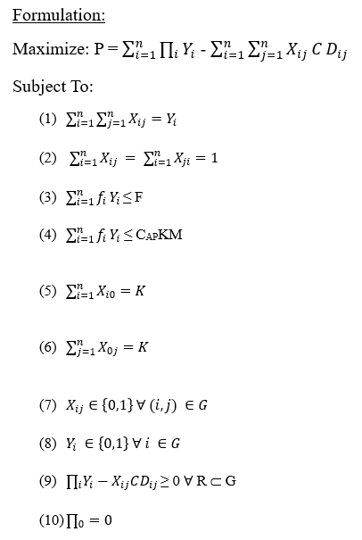
Complex VRP MILP Formulation
G = (N, A) – the network of demand nodes and arcs
C = the constant cost per distance unit (ex. $/ mile)
R = the network of all visited demand nodes and arcs
Dij = distance from node i to node j
∏i = the revenue rewarded at each destination node (the premium that customer i is willing to pay for having their demand fulfilled)
Xij = arc decision variable
Yi = node decision variable
K = the number of delivery vehicles available
P = profit function, revenue minus cost
F = Source supply capacity, the total amount of product available at the source node
CAP = Vehicle supply capacity, the fuel capacity per vehicle
M = the maximum number of trips
fi = quantity of product demanded at node i

Slide 6
Numerical Study: Algorithm Programming
The main steps of the algorithm are:
Create a solver instance.
Define the decision variables and the objective function.
Add the constraints to the solver.
Call the solver to find the optimal solution.
Print the solution if it exists.
The complexity of the algorithm depends on the size of the input data and the number of nodes and arcs in the model. The worst-case time complexity of the branch and cut algorithm is exponential, but in practice, it is often much faster due to the use of heuristics and pruning techniques.

Slide 7
Numerical Study: Algorithm Programming
The code is a Python implementation of a linear programming model. The model is a variant of the Stochastic Vehicle Routing Problem with profit maximization (VRP-SDPM) with multiple depots and profits. The objective is to maximize the total profit, subject to capacity and demand constraints.
The output of the code is the optimal solution to the model, including the objective value and the assignment of nodes to each vehicle.
The algorithm used to solve the linear programming model is the branch and cut algorithm, implemented by the ortools.linear_solver library. This library provides an interface to the COIN-OR Linear Programming (CLP) solver, which is a well-known open-source solver for linear programming problems.
To solve the model, the code creates binary decision variables X and Y, where X[i,j] is equal to 1 if arc (i,j) is used in the solution, and Y[i] is equal to 1 if node i is visited by the vehicle. The model constraints are defined using linear expressions and added to the solver. Finally, the solver is called to find the optimal solution.

Slide 8
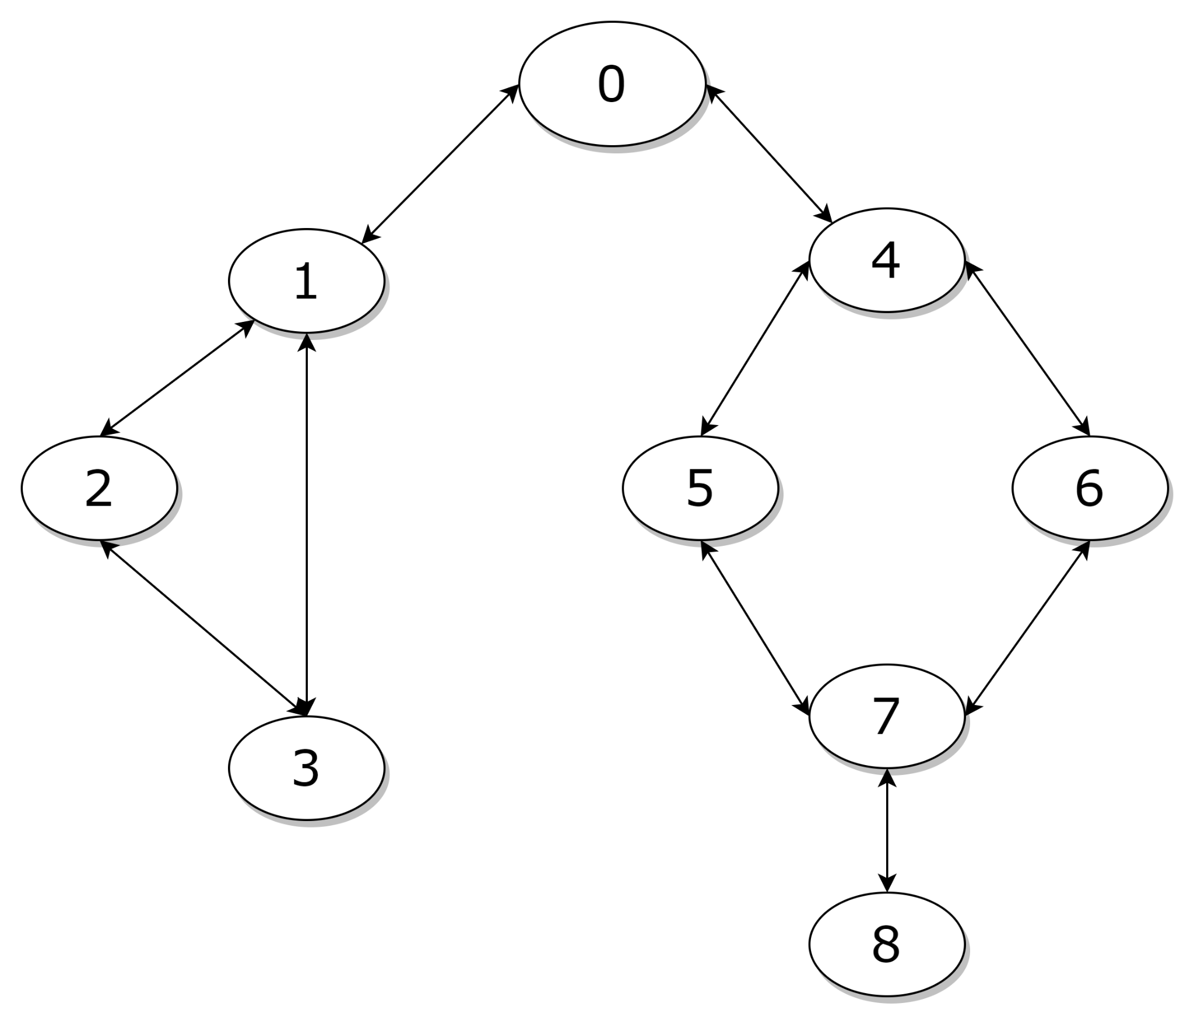
BFS Path Optimization with CUDA
Goal: Compute the optimal tour for vehicles with starting points from each node in parallel to show optimal path from each starting point of VRP sub-network
Apply BFS with CUDA to customer node network
1 Thread Per Node
Compact Adjacency List (CAL) Form
No Queues: O(n+m) time
Extend to all starting nodes

Slide 9
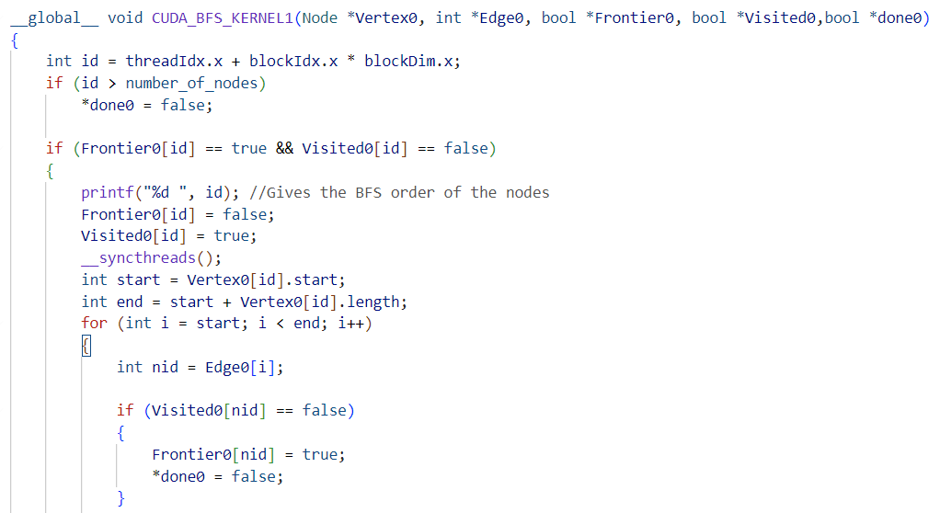
BFS Path Optimization with CUDA

Slide 10
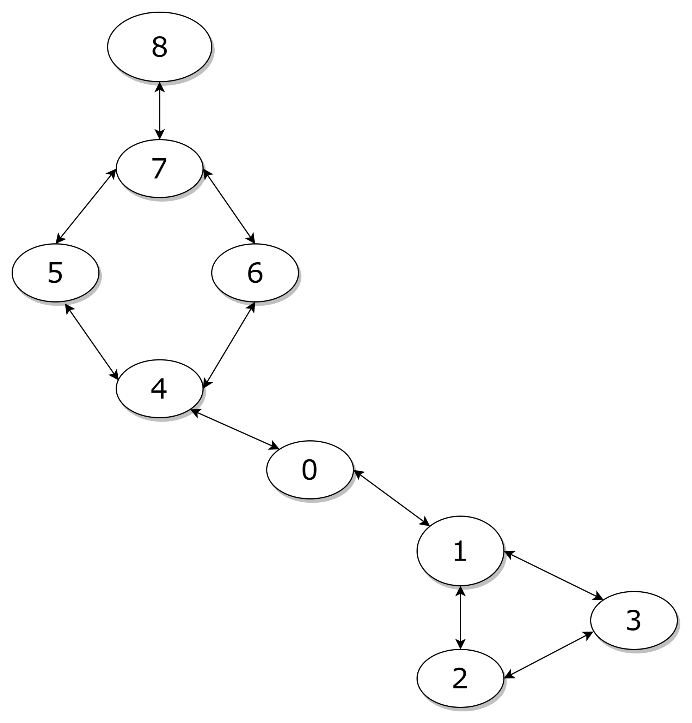
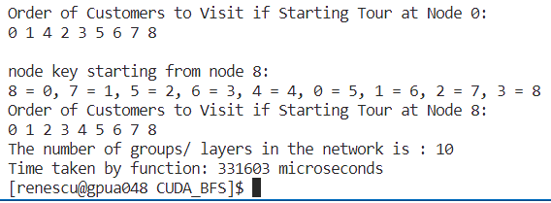
BFS Path Optimization with CUDA
Starting From Node 8
Optimal Path = 8 -> 7 -> 5 -> 6 -> 4 -> 0 -> 1 -> 2 -> 3
Results in ~1/3 seconds (over 300% efficiency)
Next Steps: CUDA Streams

Slide 11
Conclusions & Further Work - Sachit
Benefits of solving this type of problem includes:
Enhanced Supply Chain Efficiency: The formulation optimizes the delivery path and grouping demand nodes reduces transportation costs and increases vehicle capacity utilization for an efficient supply chain.
Increased Customer Satisfaction: The formulation prioritizes profitable and geographically convenient orders based on willingness to pay and distance from source node, resulting in increased customer satisfaction due to enhanced fulfillment rates and delivery times.
Improved Profitability: The formulation optimizes the delivery path for each demand node cluster based on premium fee and delivery cost, resulting in reduced transportation costs, improved vehicle utilization, and enhanced profitability of the supply chain.
Additionally, The BFS algorithm can be implemented on CUDA to traverse a complex VRP graph by partitioning it into smaller subgraphs based on available vehicles and destinations, and using the results to generate a solution that considers constraints such as vehicle capacity and demand.

Slide 12
Questions ?

